Slide 1
Package Help Bot
Archini Nayak eGain Take-Home Assignment

Slide 2
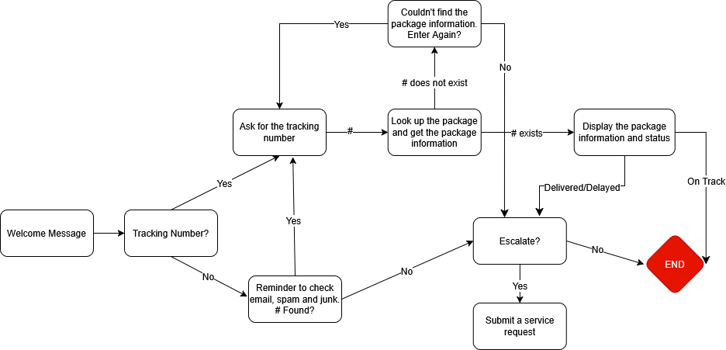
Chatbot Flow

Slide 3
Design Choices
Security: The chatbot only reveals package information upon receiving a valid tracking number.
Helpfulness: Bot gives helpful reminders, and collects information to make service requests on the customer's behalf.
Exception-safety: A smooth and error-free user experience reflects well on the company – the customer should never have a broken or buggy interface.

Slide 4
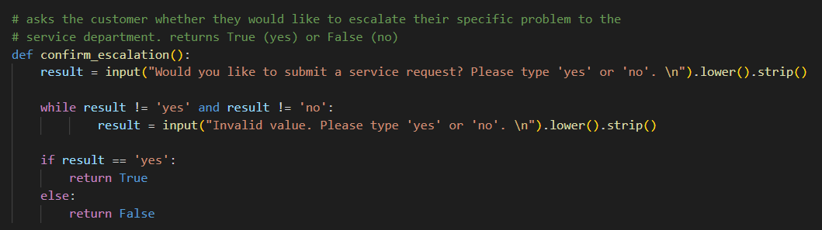




Technical Implementation
Modular functions: Each scenario has a different function. Mix-and-match scenarios and conversation flow. Super clean for future expansion.
Human-readable: Variables and functions are well-named. The central chat flow contains only scenario functions.

Slide 5
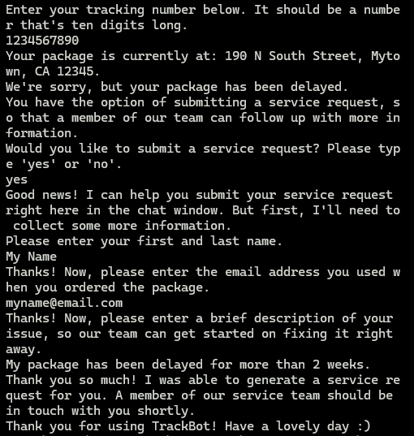
Challenges
Natural Conversation: Creating a natural conversation without bloating the chart with edge cases. Very nicely solved by the technical choice of modular functions.
Input Validation: Always a challenge.
Ask primarily yes/no questions
Find outside libraries (regex) that already validate common information types (name, email).

Slide 6
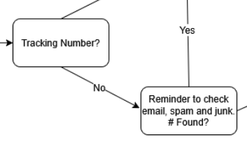
Ways to Improve
Additional lookup functionality: Implement one-time-password or two-factor auth, so customers can look up packages with email or phone number
Common issue descriptions: Analyze customer data to determine the top N most common problems ("delivered" but not received, delayed for more than 2 weeks, etc). Add the problems as options to be included with the service request, and sort the requests by urgency based on the issue.
More options at this part of the tree

